Slide 1
Design and Analysis of Algorithm
Backtracking
(Hamiltonian Cycle, Graph Coloring, Sum of subset and N-Queen)
Lecture – 50-53

Slide 2
Overview
Backtracking is a general algorithmic technique that consider searching every possible combinations in order to solve an optimization problem.
‘Backtrack’ the Word was first introduced by Dr. D.H. Lehmer in 1950s. R.J Walker Was the First man who gave algorithmic description in 1960. Later developed by S. Golamb and L. Baumert.
Based on DFS search.

Slide 3
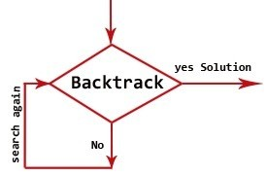
Backtracking
What is Backtracking?
  Backtracking is nothing but the modified process of the brute force approach. where the technique systematically searches for a solution to a problem among all available options. It does so by assuming that the solutions are represented by vectors (v1, ..., in) of values and by traversing through the domains of the vectors until the solutions is found.

Slide 4
Backtracking
Algorithmic Approach
  Test whether a solution has been found.
  If found a solution, then return it
  Else for each choice that can be made
    Make that choice
    Recur
    If recurrence returns a solution, return it.
  If no choice remain, return failure.
Sometimes called a “Search Tree”.

Slide 5
Backtracking
Problems
  Hamiltonian cycle
  Graph Coloring
  Sum of subset
  N-Queen

Slide 6
Backtracking
Problems
  Hamiltonian cycle
  Graph Coloring
  Sum of subset
  N-Queen

Slide 7
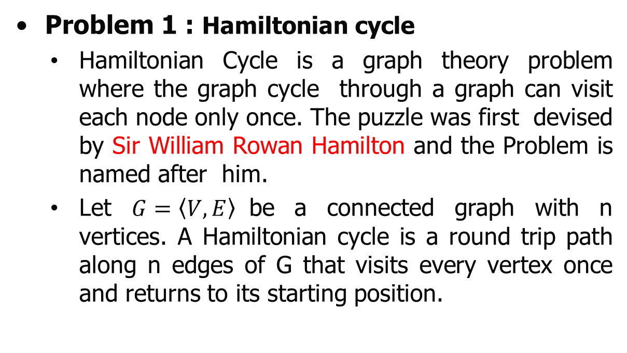
Backtracking
Problem 1 : Hamiltonian cycle
  Hamiltonian Cycle is a graph theory problem where the graph cycle through a graph can visit each node only once. The puzzle was first devised by Sir William Rowan Hamilton and the Problem is named after him.
  Let $G=\left\langle V,E\right\rangle$be a connected graph with n vertices. A Hamiltonian cycle is a round trip path along n edges of G that visits every vertex once and returns to its starting position.

Slide 8
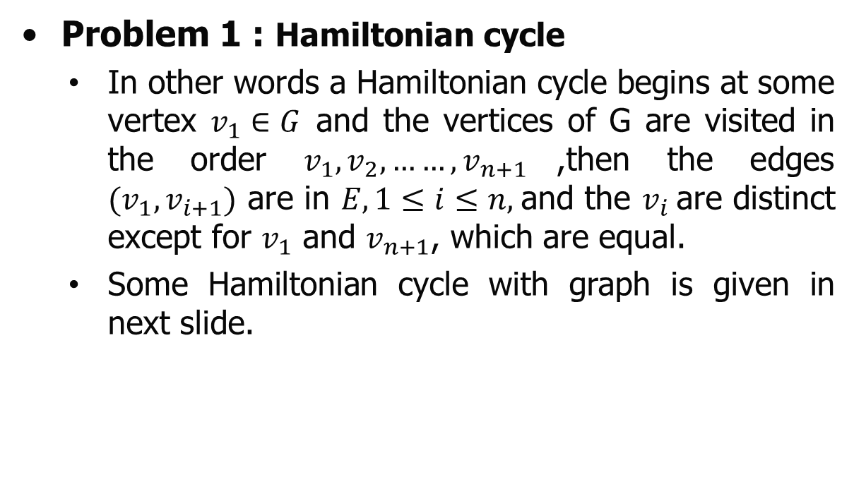
Backtracking
Problem 1 : Hamiltonian cycle
  In other words a Hamiltonian cycle begins at some vertex $v_{1}∈G$ and the vertices of G are visited in the order $v_{1},v_{2},……,v_{n+1}$,then the edges $(v_{1},v_{i+1})$ are in $E, 1≤i≤n,$and the $v_{i}$are distinct except for $v_{1}$ and $v_{n+1}$, which are equal.
  Some Hamiltonian cycle with graph is given in next slide.

Slide 9
Backtracking
Problem 1 : Hamiltonian cycle
1
2
3
1 2 3 4 5 6 1
1 2 6 5 4 3 1
1 6 2 5 4 3 1
6
5
4
2
3
1 2 3 5 4 1
1 2 4 5 3 1
5
1
4

Slide 10
Backtracking
Problem 1 : Hamiltonian cycle
1
2
3
Hamiltonian cycle is not exist in this graph
4
5
6
7
1
5
Hamiltonian cycle is not exist in this graph because of Articulation point vertex.
2
3
4
6

Slide 11
Backtracking
Problem 1 : Hamiltonian cycle
Let’s find how backtracking is help us for finding the Hamiltonian cycle.
Hamiltonian cycle is not exist in this graph because of Pendent vertex.
3
6
1
4
2
5

Slide 12
Backtracking
Problem 1 : Hamiltonian cycle
Example 1: Find the Hamiltonian cycle of the given graph by using backtracking.
1
2
3
5
4

Slide 13
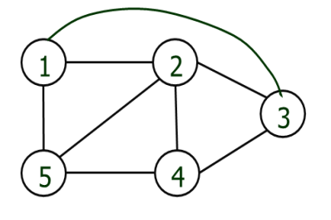
Backtracking
Draw by himself/herself
Problem 1 : Hamiltonian cycle
Example 1: Find the Hamiltonian cycle of the given graph by using backtracking. First find the state space tree.

Slide 14
Backtracking
Problem 1 : Hamiltonian cycle
Example 1: Find the Hamiltonian cycle of the given graph by using backtracking.
 | 1 | 2 | 3 | 4 | 5
1 | 0 | 1 | 1 | 0 | 1
2 | 1 | 0 | 1 | 1 | 1
3 | 1 | 1 | 0 | 1 | 0
4 | 0 | 1 | 1 | 0 | 1
5 | 1 | 1 | 0 | 1 | 0
1
2
3
5
4
Adjacent Matrix

Slide 15
Backtracking
Problem 1 : Hamiltonian cycle
Example 1: Find the Hamiltonian cycle of the given graph by using backtracking.
 | 1 | 2 | 3 | 4 | 5
1 | 0 | 1 | 1 | 0 | 1
2 | 1 | 0 | 1 | 1 | 1
3 | 1 | 1 | 0 | 1 | 0
4 | 0 | 1 | 1 | 0 | 1
5 | 1 | 1 | 0 | 1 | 0
1
2
3
5
4
Adjacent Matrix
1 | 2 | 3 | 4 | 5
0 | 0 | 0 | 0 | 0
x
State Space Tree

Slide 16
Backtracking
Problem 1 : Hamiltonian cycle
Example 1: Find the Hamiltonian cycle of the given graph by using backtracking.
 | 1 | 2 | 3 | 4 | 5
1 | 0 | 1 | 1 | 0 | 1
2 | 1 | 0 | 1 | 1 | 1
3 | 1 | 1 | 0 | 1 | 0
4 | 0 | 1 | 1 | 0 | 1
5 | 1 | 1 | 0 | 1 | 0
1
1
2
3
5
4
Adjacent Matrix
1 | 2 | 3 | 4 | 5
1 | 0 | 0 | 0 | 0
x
State Space Tree

Slide 17
Backtracking
Problem 1 : Hamiltonian cycle
Example 1: Find the Hamiltonian cycle of the given graph by using backtracking.
 | 1 | 2 | 3 | 4 | 5
1 | 0 | 1 | 1 | 0 | 1
2 | 1 | 0 | 1 | 1 | 1
3 | 1 | 1 | 0 | 1 | 0
4 | 0 | 1 | 1 | 0 | 1
5 | 1 | 1 | 0 | 1 | 0
1
1
2
3
5
4
Adjacent Matrix
1 | 2 | 3 | 4 | 5
1 | 1 | 0 | 0 | 0
x
Node 1 already selected so we can’t select it again. So we go for node 2.
State Space Tree

Slide 18
Backtracking
Problem 1 : Hamiltonian cycle
Example 1: Find the Hamiltonian cycle of the given graph by using backtracking.
 | 1 | 2 | 3 | 4 | 5
1 | 0 | 1 | 1 | 0 | 1
2 | 1 | 0 | 1 | 1 | 1
3 | 1 | 1 | 0 | 1 | 0
4 | 0 | 1 | 1 | 0 | 1
5 | 1 | 1 | 0 | 1 | 0
1
2
1
2
3
5
4
Adjacent Matrix
1 | 2 | 3 | 4 | 5
1 | 2 | 0 | 0 | 0
x
Node 1 already selected so we can’t select it again. So we go for node 2.
State Space Tree

Slide 19
Backtracking
Problem 1 : Hamiltonian cycle
Example 1: Find the Hamiltonian cycle of the given graph by using backtracking.
 | 1 | 2 | 3 | 4 | 5
1 | 0 | 1 | 1 | 0 | 1
2 | 1 | 0 | 1 | 1 | 1
3 | 1 | 1 | 0 | 1 | 0
4 | 0 | 1 | 1 | 0 | 1
5 | 1 | 1 | 0 | 1 | 0
1
2
1
2
3
5
4
Adjacent Matrix
1 | 2 | 3 | 4 | 5
1 | 2 | 0 | 0 | 0
x
Node 1 already selected so we can’t select it again. So we go for node 2.
State Space Tree

Slide 20
Backtracking
Problem 1 : Hamiltonian cycle
Example 1: Find the Hamiltonian cycle of the given graph by using backtracking.
 | 1 | 2 | 3 | 4 | 5
1 | 0 | 1 | 1 | 0 | 1
2 | 1 | 0 | 1 | 1 | 1
3 | 1 | 1 | 0 | 1 | 0
4 | 0 | 1 | 1 | 0 | 1
5 | 1 | 1 | 0 | 1 | 0
1
2
1
2
3
5
4
Adjacent Matrix
1 | 2 | 3 | 4 | 5
1 | 2 | 1 | 0 | 0
x
Node 1 already selected so we can’t select it again. So we go for node 2.
State Space Tree

Slide 21
Backtracking
Problem 1 : Hamiltonian cycle
Example 1: Find the Hamiltonian cycle of the given graph by using backtracking.
 | 1 | 2 | 3 | 4 | 5
1 | 0 | 1 | 1 | 0 | 1
2 | 1 | 0 | 1 | 1 | 1
3 | 1 | 1 | 0 | 1 | 0
4 | 0 | 1 | 1 | 0 | 1
5 | 1 | 1 | 0 | 1 | 0
1
2
1
2
3
5
4
Adjacent Matrix
1 | 2 | 3 | 4 | 5
1 | 2 | 2 | 0 | 0
x
Node 2 already selected so we can’t select it again. So we go for node 3.
State Space Tree

Slide 22
Backtracking
Problem 1 : Hamiltonian cycle
Example 1: Find the Hamiltonian cycle of the given graph by using backtracking.
 | 1 | 2 | 3 | 4 | 5
1 | 0 | 1 | 1 | 0 | 1
2 | 1 | 0 | 1 | 1 | 1
3 | 1 | 1 | 0 | 1 | 0
4 | 0 | 1 | 1 | 0 | 1
5 | 1 | 1 | 0 | 1 | 0
1
2
1
2
3
3
5
4
Adjacent Matrix
1 | 2 | 3 | 4 | 5
1 | 2 | 3 | 0 | 0
x
Node 2 already selected so we can’t select it again. So we go for node 3.
State Space Tree

Slide 23
Backtracking
Problem 1 : Hamiltonian cycle
Example 1: Find the Hamiltonian cycle of the given graph by using backtracking.
 | 1 | 2 | 3 | 4 | 5
1 | 0 | 1 | 1 | 0 | 1
2 | 1 | 0 | 1 | 1 | 1
3 | 1 | 1 | 0 | 1 | 0
4 | 0 | 1 | 1 | 0 | 1
5 | 1 | 1 | 0 | 1 | 0
1
2
1
2
3
3
5
4
Adjacent Matrix
1 | 2 | 3 | 4 | 5
1 | 2 | 3 | 0 | 0
x
Node 2 already selected so we can’t select it again. So we go for node 3.
State Space Tree

Slide 24
Backtracking
Problem 1 : Hamiltonian cycle
Example 1: Find the Hamiltonian cycle of the given graph by using backtracking.
 | 1 | 2 | 3 | 4 | 5
1 | 0 | 1 | 1 | 0 | 1
2 | 1 | 0 | 1 | 1 | 1
3 | 1 | 1 | 0 | 1 | 0
4 | 0 | 1 | 1 | 0 | 1
5 | 1 | 1 | 0 | 1 | 0
1
2
1
2
3
3
5
4
Adjacent Matrix
1 | 2 | 3 | 4 | 5
1 | 2 | 3 | 1 | 0
x
Node 1 already selected so we can’t select it again. So we go for node 2.
State Space Tree

Slide 25
Backtracking
Problem 1 : Hamiltonian cycle
Example 1: Find the Hamiltonian cycle of the given graph by using backtracking.
 | 1 | 2 | 3 | 4 | 5
1 | 0 | 1 | 1 | 0 | 1
2 | 1 | 0 | 1 | 1 | 1
3 | 1 | 1 | 0 | 1 | 0
4 | 0 | 1 | 1 | 0 | 1
5 | 1 | 1 | 0 | 1 | 0
1
2
1
2
3
3
5
4
Adjacent Matrix
1 | 2 | 3 | 4 | 5
1 | 2 | 3 | 2 | 0
x
Node 2 already selected so we can’t select it again. So we go for node 3.
State Space Tree

Slide 26
Backtracking
Problem 1 : Hamiltonian cycle
Example 1: Find the Hamiltonian cycle of the given graph by using backtracking.
 | 1 | 2 | 3 | 4 | 5
1 | 0 | 1 | 1 | 0 | 1
2 | 1 | 0 | 1 | 1 | 1
3 | 1 | 1 | 0 | 1 | 0
4 | 0 | 1 | 1 | 0 | 1
5 | 1 | 1 | 0 | 1 | 0
1
2
1
2
3
3
5
4
Adjacent Matrix
1 | 2 | 3 | 4 | 5
1 | 2 | 3 | 3 | 0
x
Node 3 already selected so we can’t select it again. So we go for node 4.
State Space Tree

Slide 27
Backtracking
Problem 1 : Hamiltonian cycle
Example 1: Find the Hamiltonian cycle of the given graph by using backtracking.
 | 1 | 2 | 3 | 4 | 5
1 | 0 | 1 | 1 | 0 | 1
2 | 1 | 0 | 1 | 1 | 1
3 | 1 | 1 | 0 | 1 | 0
4 | 0 | 1 | 1 | 0 | 1
5 | 1 | 1 | 0 | 1 | 0
1
2
1
2
3
3
5
4
Adjacent Matrix
4
1 | 2 | 3 | 4 | 5
1 | 2 | 3 | 4 | 0
x
Node 3 already selected so we can’t select it again. So we go for node 4.
State Space Tree

Slide 28
Backtracking
Problem 1 : Hamiltonian cycle
Example 1: Find the Hamiltonian cycle of the given graph by using backtracking.
 | 1 | 2 | 3 | 4 | 5
1 | 0 | 1 | 1 | 0 | 1
2 | 1 | 0 | 1 | 1 | 1
3 | 1 | 1 | 0 | 1 | 0
4 | 0 | 1 | 1 | 0 | 1
5 | 1 | 1 | 0 | 1 | 0
1
2
1
2
3
3
5
4
Adjacent Matrix
4
1 | 2 | 3 | 4 | 5
1 | 2 | 3 | 4 | 1
x
Node 1 already selected so we can’t select it again. So we go for node 2.
State Space Tree

Slide 29
Backtracking
Problem 1 : Hamiltonian cycle
Example 1: Find the Hamiltonian cycle of the given graph by using backtracking.
 | 1 | 2 | 3 | 4 | 5
1 | 0 | 1 | 1 | 0 | 1
2 | 1 | 0 | 1 | 1 | 1
3 | 1 | 1 | 0 | 1 | 0
4 | 0 | 1 | 1 | 0 | 1
5 | 1 | 1 | 0 | 1 | 0
1
2
1
2
3
3
5
4
Adjacent Matrix
4
1 | 2 | 3 | 4 | 5
1 | 2 | 3 | 4 | 2
x
Node 2 already selected so we can’t select it again. So we go for node 3.
State Space Tree

Slide 30
Backtracking
Problem 1 : Hamiltonian cycle
Example 1: Find the Hamiltonian cycle of the given graph by using backtracking.
 | 1 | 2 | 3 | 4 | 5
1 | 0 | 1 | 1 | 0 | 1
2 | 1 | 0 | 1 | 1 | 1
3 | 1 | 1 | 0 | 1 | 0
4 | 0 | 1 | 1 | 0 | 1
5 | 1 | 1 | 0 | 1 | 0
1
2
1
2
3
3
5
4
Adjacent Matrix
4
1 | 2 | 3 | 4 | 5
1 | 2 | 3 | 4 | 3
x
Node 3 already selected so we can’t select it again. So we go for node 4.
State Space Tree

Slide 31
Backtracking
Problem 1 : Hamiltonian cycle
Example 1: Find the Hamiltonian cycle of the given graph by using backtracking.
 | 1 | 2 | 3 | 4 | 5
1 | 0 | 1 | 1 | 0 | 1
2 | 1 | 0 | 1 | 1 | 1
3 | 1 | 1 | 0 | 1 | 0
4 | 0 | 1 | 1 | 0 | 1
5 | 1 | 1 | 0 | 1 | 0
1
2
1
2
3
3
5
4
Adjacent Matrix
4
1 | 2 | 3 | 4 | 5
1 | 2 | 3 | 4 | 5
x
5
Node 4 already selected so we can’t select it again. So we go for node 5.
State Space Tree

Slide 32

Backtracking
Problem 1 : Hamiltonian cycle
Example 1: Find the Hamiltonian cycle of the given graph by using backtracking.
 | 1 | 2 | 3 | 4 | 5
1 | 0 | 1 | 1 | 0 | 1
2 | 1 | 0 | 1 | 1 | 1
3 | 1 | 1 | 0 | 1 | 0
4 | 0 | 1 | 1 | 0 | 1
5 | 1 | 1 | 0 | 1 | 0
1
2
1
2
3
3
5
4
Adjacent Matrix
4
1 | 2 | 3 | 4 | 5
1 | 2 | 3 | 4 | 5
x
5
Hamilton cycle: $1→2→3→4→5→1$
State Space Tree

Slide 33

Backtracking
Problem 1 : Hamiltonian cycle
Example 1: Find the Hamiltonian cycle of the given graph by using backtracking.
The complete state space tree is shown in next slide.
 | 1 | 2 | 3 | 4 | 5
1 | 0 | 1 | 1 | 0 | 1
2 | 1 | 0 | 1 | 1 | 1
3 | 1 | 1 | 0 | 1 | 0
4 | 0 | 1 | 1 | 0 | 1
5 | 1 | 1 | 0 | 1 | 0
1
2
1
2
3
3
5
4
Adjacent Matrix
4
1 | 2 | 3 | 4 | 5
1 | 2 | 3 | 4 | 5
x
5
State Space Tree
Hamilton cycle: $1→2→3→4→5→1$

Slide 34
Backtracking
Problem 1 : Hamiltonian cycle
Example 1: Find the Hamiltonian cycle of the given graph by using backtracking.
Similarly do it for starting node 2.(Self practice)
 | 1 | 2 | 3 | 4 | 5
1 | 0 | 1 | 1 | 0 | 1
2 | 1 | 0 | 1 | 1 | 1
3 | 1 | 1 | 0 | 1 | 0
4 | 0 | 1 | 1 | 0 | 1
5 | 1 | 1 | 0 | 1 | 0
1
2
1
2
3
3
4
5
5
4
Adjacent Matrix
4
3
5
4
1 | 2 | 3 | 4 | 5
1 | 2 | 3 | 4 | 5
x
5
5
State Space Tree
Hamilton cycle: $1→2→3→4→5→1$

Slide 35
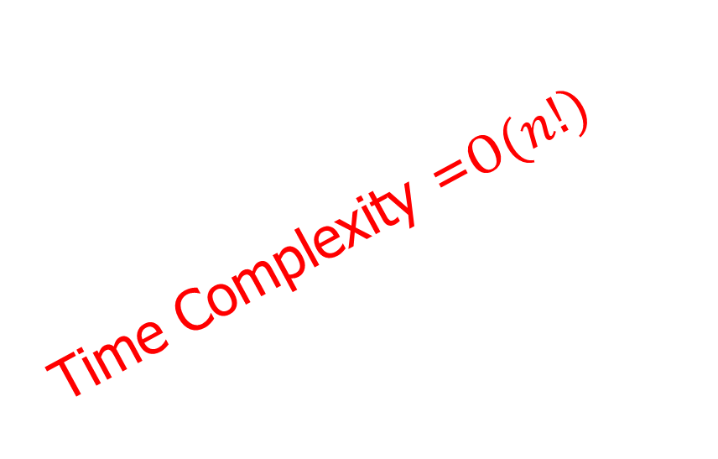
Backtracking
Problem 1 : Hamiltonian cycle
Example 1: Find the Hamiltonian cycle of the given graph by using backtracking.
Similarly do it for starting node 2.(Self practice)
 | 1 | 2 | 3 | 4 | 5
1 | 0 | 1 | 1 | 0 | 1
2 | 1 | 0 | 1 | 1 | 1
3 | 1 | 1 | 0 | 1 | 0
4 | 0 | 1 | 1 | 0 | 1
5 | 1 | 1 | 0 | 1 | 0
1
Time Complexity =$Ο(n!)$
2
1
2
3
3
4
5
5
4
Adjacent Matrix
4
3
3
4
1 | 2 | 3 | 4 | 5
1 | 2 | 3 | 4 | 5
x
5
5
State Space Tree
Hamilton cycle: $1→2→3→4→5→1$

Slide 36
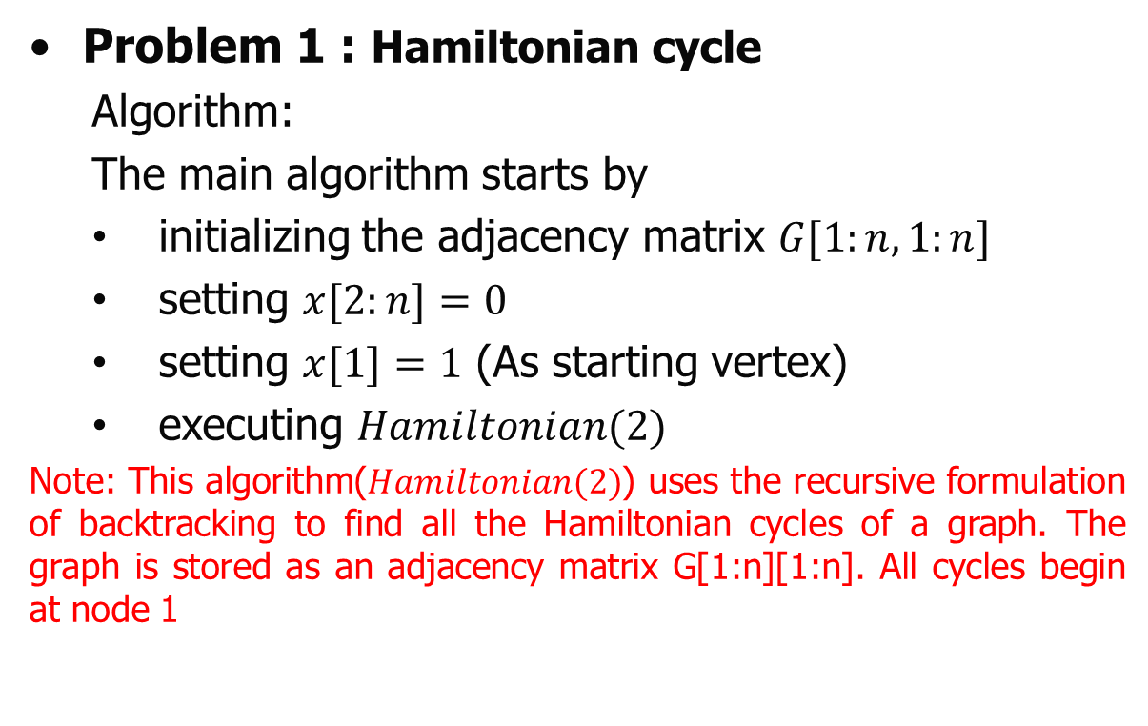
Backtracking
Problem 1 : Hamiltonian cycle
  Algorithm:
  The main algorithm starts by
  initializing the adjacency matrix $G[1:n,1:n]$
  setting $x[2:n]=0$
  setting $x[1]=1$ (As starting vertex)
  executing $Hamiltonian(2)$
Note: This algorithm($Hamiltonian(2)$) uses the recursive formulation of backtracking to find all the Hamiltonian cycles of a graph. The graph is stored as an adjacency matrix G[1:n][1:n]. All cycles begin at node 1

Slide 37
Backtracking
Problem 1 : Hamiltonian cycle
  Algorithm:
  Recursive algorithm that finds all Hamiltonian cycles
void Hamiltonian(int k)
{
repeat
{ // Generate values for x[k].
NextValue(k); // Assign a legal next value to x[k].
if (x[k]==0) the return;
if (k == n) then print([1:n])
else Hamiltonian(k+1);
} until (false);
}

Slide 38
Backtracking
The NextValue(int k) searching is execute on following procedure:
  x[1],...,x[k-1] is a path of k-1 distinct vertices.
  If x[k]==0, no vertex has yet been assigned to x[k].
  After execution x[k] is assigned to the lowest numbered vertex that does not already appear in x[1],x[2],...,x[k-1]; and is connected by an edge to [k-1] Otherwise x[k]==0, If k==n, then in addition x[k] is connected to x[1].

Slide 39
Backtracking
Problem 1 : Hamiltonian cycle
  Algorithm:
void NextValue(int k)
{
repeat
{
x[k] = (x[k]+1) % (n+1); // Next vertex
if (x[k]==0) then return;
if (G[x[k-1]][x[k]]==0) then
{ // Is there an edge?
for (j=1 to k-a) do
if (x[j]==x[k]) then break; // Check for distinctness.
if (j==k) then // If true, then the vertex is distinct.
if ((k<n) || ((k==n) && G[x[n]][x[1]]!=0))
then return;
}
} until(false);
}

Slide 40
Backtracking
Problems
  Hamiltonian cycle
  Graph Coloring
  Sum of subset
  N-Queen

Slide 41
Backtracking
Problem 2 : Graph Coloring
  Given an undirected graph and a number m, determine if the graph can be colored with at most m colors such that no two adjacent vertices of the graph are colored with same color. (Hear coloring of a graph means assignment of colors to all vertices)

Slide 42
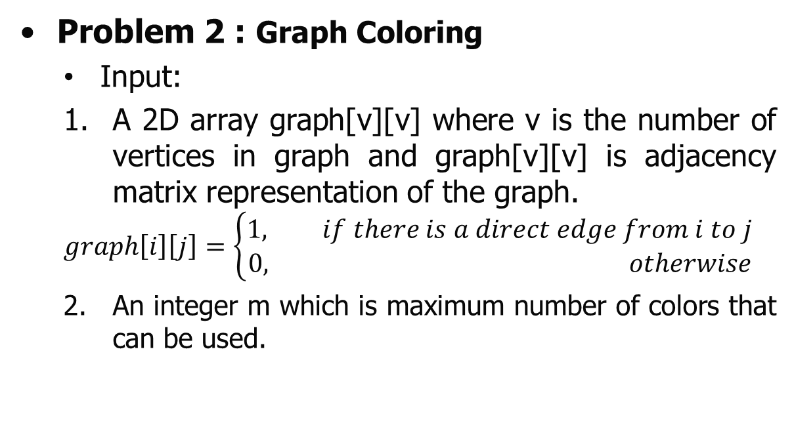
Backtracking
Problem 2 : Graph Coloring
  Input:
  A 2D array graph[v][v] where v is the number of vertices in graph and graph[v][v] is adjacency matrix representation of the graph.
  $$graph\left[i\right]\left[j\right]=\left\{\begin{aligned}1, if there is a direct edge from i to j \\ &0, otherwise\end{aligned}\right.$$
  An integer m which is maximum number of colors that can be used.

Slide 43
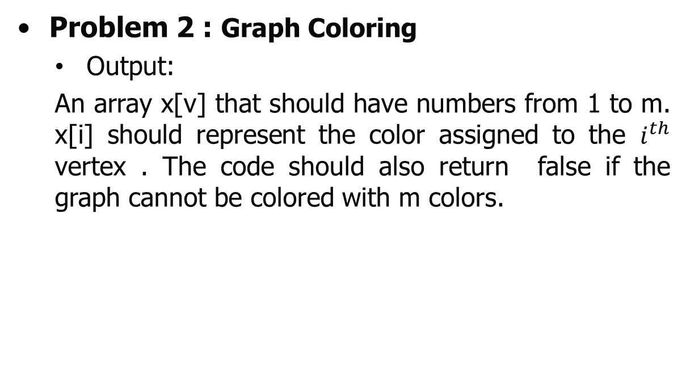
Backtracking
Problem 2 : Graph Coloring
  Output:
  An array x[v] that should have numbers from 1 to m. x[i] should represent the color assigned to the $i^{th}$ vertex . The code should also return false if the graph cannot be colored with m colors.

Slide 44
Backtracking
Problem 2 : Graph Coloring
  Example: Colored the following graph G by using three colour (Red, Green and Blue) and draw the state space tree by using Brute force method.
1
2
4
3

Slide 45


































Backtracking
Problem 2 : Graph Coloring
  Example: Colored the following graph G by using three colour (Red, Green and Blue) and draw the state space tree by using Brute force method.
Root
1
2
$$x_{1}=$$
$$R$$
$$G$$
$$B$$
$$x_{2}=$$
$$R$$
$$G$$
$$B$$
$$R$$
$$G$$
$$B$$
$$R$$
$$G$$
$$B$$
4
3
Graph G
$$x_{3}=$$
$$R$$
$$G$$
$$B$$
$$R$$
$$G$$
$$B$$
$$R$$
$$G$$
$$B$$
$$R$$
$$G$$
$$B$$
$$R$$
$$G$$
$$B$$
$$R$$
$$G$$
$$B$$
$$x_{4}=$$
State space tree
(Brute force method)

Slide 46
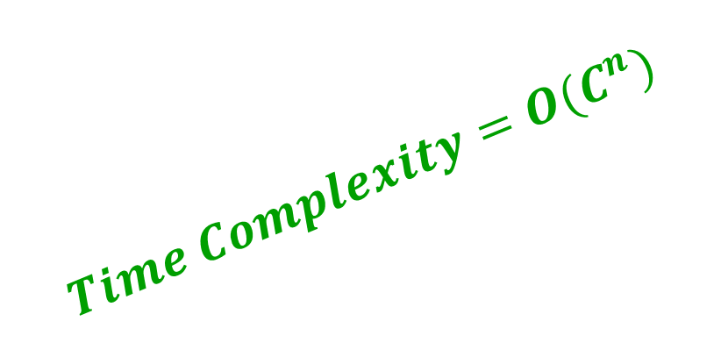
Backtracking
Problem 2 : Graph Coloring
  Example: Colored the following graph G by using three colour (Red, Green and Blue) and draw the state space tree by using Brute force method.
Root
1
2
$$x_{1}=$$
$$R$$
$$G$$
$$B$$
$$x_{2}=$$
$$R$$
$$G$$
$$B$$
$$R$$
$$G$$
$$B$$
$$R$$
$$G$$
$$B$$
4
3
Graph G
$$x_{3}=$$
$$R$$
$$G$$
$$B$$
$$R$$
$$G$$
$$B$$
$$R$$
$$G$$
$$B$$
$$R$$
$$G$$
$$B$$
$$Time Complexity=O(C^{n})$$
$$R$$
$$G$$
$$B$$
$$R$$
$$G$$
$$B$$
$$x_{4}=$$
State space tree
(Brute force method)

Slide 47







































Backtracking
Problem 2 : Graph Coloring
  Example: Colored the following graph G by using three colour (Red, Green and Blue) and draw the state space tree by using Backtracking method.
Root
1
2
$$x_{1}=$$
$$R$$
$$G$$
$$B$$
$$x_{2}=$$
$$R$$
$$G$$
$$B$$
$$R$$
$$G$$
$$B$$
$$R$$
$$G$$
$$B$$
4
3
Graph G
$$x_{3}=$$
$$R$$
$$B$$
$$R$$
$$G$$
$$B$$
$$B$$
$$G$$
$$R$$
$$G$$
$$x_{4}=$$
$$R$$
$$B$$
$$R$$
$$B$$
$$G$$
$$G$$
$$R$$
$$B$$
$$G$$
$$S_{1}$$
$$S_{2}$$
$$S_{5}$$
$$S_{3}$$
$$S_{4}$$
State space tree (Backtracking)

Slide 48
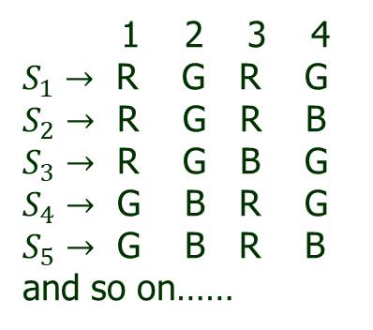
Backtracking
Problem 2 : Graph Coloring
  Example: Colored the following graph G by using three colour (Red, Green and Blue) and draw the state space tree by using Backtracking method.
Root
1
2
$$x_{1}=$$
$$R$$
$$G$$
$$B$$
$$x_{2}=$$
$$R$$
$$G$$
$$B$$
$$R$$
$$G$$
$$B$$
$$R$$
$$G$$
$$B$$
4
3
Graph G
$$x_{3}=$$
$$R$$
$$B$$
$$R$$
$$G$$
$$B$$
$$B$$
1 2 3 4
$S_{1}→$ R G R G
$S_{2}→$ R G R B
$S_{3}→$ R G B G
$S_{4}→$ G B R G
$S_{5}→$ G B R B
and so on……
$$G$$
$$R$$
$$G$$
$$x_{4}=$$
$$R$$
$$B$$
$$R$$
$$B$$
$$G$$
$$G$$
$$R$$
$$B$$
$$G$$
$$S_{1}$$
$$S_{2}$$
$$S_{5}$$
$$S_{3}$$
$$S_{4}$$
State space tree (Backtracking)
(Possible Solutions)

Slide 49
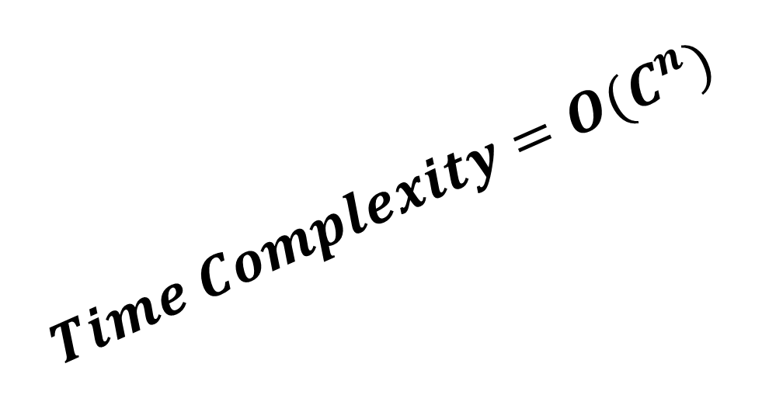
Backtracking
Problem 2 : Graph Coloring
  Example: Colored the following graph G by using three colour (Red, Green and Blue) and draw the state space tree by using Backtracking method.
Root
1
2
$$x_{1}=$$
$$R$$
$$G$$
$$B$$
$$x_{2}=$$
$$R$$
$$G$$
$$B$$
$$R$$
$$G$$
$$B$$
$$R$$
$$G$$
$$B$$
4
3
$$Time Complexity=O(C^{n})$$
Graph G
$$x_{3}=$$
$$R$$
$$B$$
$$R$$
$$G$$
$$B$$
$$B$$
1 2 3 4
$S_{1}→$ R G R G
$S_{2}→$ R G R B
$S_{3}→$ R G B G
$S_{4}→$ G B R G
$S_{5}→$ G B R B
and so on……
$$G$$
$$R$$
$$G$$
$$x_{4}=$$
$$R$$
$$B$$
$$R$$
$$B$$
$$G$$
$$G$$
$$R$$
$$B$$
$$G$$
$$S_{1}$$
$$S_{2}$$
$$S_{5}$$
$$S_{3}$$
$$S_{4}$$
State space tree (Backtracking)
(Possible Solutions)

Slide 50
Backtracking
Problem 2 : Graph Coloring
  Algorithm:
  Recursive algorithm that finds all Hamiltonian cycles
  This program was formed using the recursive backtracking scheme. The graph is represented by its Boolean adjacency matrix G[1:n][1:n]. ssignments of 1,2,….,m
  to find the vertices of the graph such that adjacent vertices are assigned distinct integers are printed. Hear k is the next vertex to color.

Slide 51
Backtracking
Problem 2 : Graph Coloring
This algorithm mcoloring (k) was formed using the recursive backtracking schema. The graph is represented by its Boolean adjacency matrix G [1: n, 1: n]. All assignments of1, 2,.......... , m to the vertices of the graph such that adjacent vertices are assigned distinct integers are printed. k is the index of the next vertex to color.

Slide 52
Backtracking
Problem 2 : Graph Coloring
Algorithm mcoloring (k)
{
repeat
{ // Generate all legal assignments for x[k].
NextValue (k); // Assign to x [k] a legal color.
If (x [k] = 0) then return; // No new color possible
If (k = n) then // at most m colors have been used to
color the n vertices.
write (x [1: n]);
else
mcoloring (k+1);
} until (false);
}

Slide 53
Backtracking
Problem 2 : Graph Coloring
  The Execution procedure of function NextValue(int k):
  x[1],...,x[k-1] have been assigned integer values in the range[1,m] such that adjacent vertices have distinct integers. A value for x[k] determined in the range [0,m].
  X[k] is assigned the next highest numbered color while maintain distinctness from the adjacent vertices of vertex k.
  If no such color exits, then x[k]=0.

Slide 54
Backtracking
Problem 2 : Graph Coloring
void NextValue(int k)
{repeat
{
x[k] = (x[k]+1) % (n+1); // Next vertex
if (x[k]==0) return;
for j=1 to n do
{
// Check if this color is distinct from adjacent colors
if ((G[k][j]!=0) and (x[k]==x[j]))
//if (k,j) is and edge and if adjacent vertices have the same color
then break;
}
if (j=n+1) then return;// New color found
} until(false); // Otherwise try to find another color
}

Slide 55
Backtracking
Problems
  Hamiltonian cycle
  Graph Coloring
  Sum of subset
  N-Queen

Slide 56
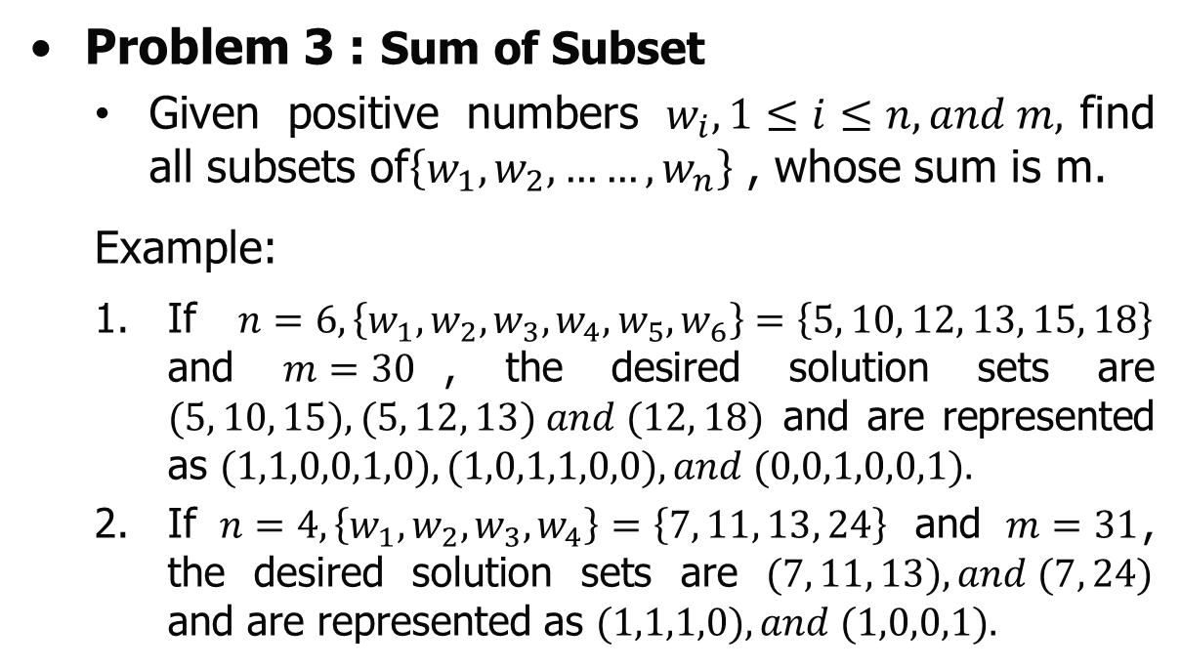
Backtracking
Problem 3 : Sum of Subset
  Given positive numbers $w_{i}, 1≤i≤n, and m,$find all subsets of$\left\{w_{1},w_{2},……,w_{n}\right\}$ , whose sum is m.
  Example:
  If $n=6,\left\{w_{1},w_{2},w_{3},w_{4},w_{5},w_{6}\right\}=\left\{5, 10, 12, 13, 15, 18\right\}$ and $m=30$, the desired solution sets are $(5, 10, 15), (5, 12, 13) and (12, 18)$ and are represented as $(1,1,0,0,1,0), (1,0,1,1,0,0), and (0,0,1,0,0,1).$
  If $n=4,\left\{w_{1},w_{2},w_{3},w_{4}\right\}=\left\{7, 11, 13, 24\right\}$ and $m=31$, the desired solution sets are $(7, 11, 13), and (7, 24)$ and are represented as $(1,1,1,0), and (1,0,0,1).$

Slide 57
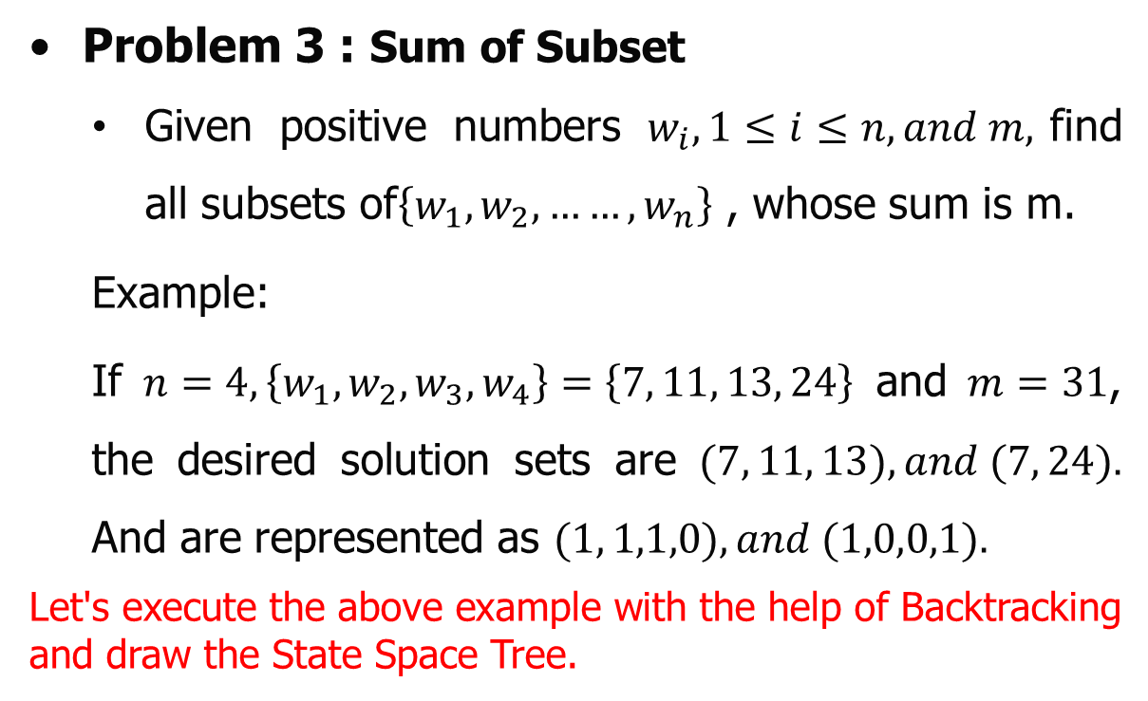
Backtracking
Problem 3 : Sum of Subset
  Given positive numbers $w_{i}, 1≤i≤n, and m,$find all subsets of$\left\{w_{1},w_{2},……,w_{n}\right\}$ , whose sum is m.
  Example:
  If $n=4,\left\{w_{1},w_{2},w_{3},w_{4}\right\}=\left\{7, 11, 13, 24\right\}$ and $m=31$, the desired solution sets are $(7, 11, 13), and (7, 24).$ And are represented as $(1, 1,1,0), and (1,0,0,1).$
Let's execute the above example with the help of Backtracking and draw the State Space Tree.

Slide 58
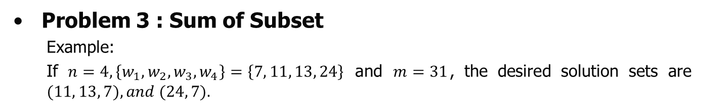



Backtracking
Problem 3 : Sum of Subset
  Example:
  If $n=4,\left\{w_{1},w_{2},w_{3},w_{4}\right\}=\left\{7, 11, 13, 24\right\}$ and $m=31$, the desired solution sets are $(11, 13, 7), and (24, 7).$
S | K | R
0 | 1 | 55
1 | 2 | 3 | 4
7 | 11 | 13 | 24
$$x_{1}→$$
$$1$$
$$0$$
S | K | R
7 | 1 | 48
S | K | R
0 | 1 | 48

Slide 59



Backtracking
Problem 3 : Sum of Subset
  Example:
  If $n=4,\left\{w_{1},w_{2},w_{3},w_{4}\right\}=\left\{7, 11, 13, 24\right\} \text{and} m=31$, the desired solution sets are $(11, 13, 7), and (24, 7).$
S | K | R
0 | 1 | 55
1 | 2 | 3 | 4
7 | 11 | 13 | 24
$$x_{1}→$$
$$1$$
$$0$$
S | K | R
7 | 1 | 48
S | K | R
0 | 1 | 48
$$x_{2}→$$
$$1$$
$$0$$
$$1$$
$$0$$
S | K | R
18 | 2 | 37
S | K | R
7 | 2 | 37
S | K | R
11 | 2 | 37
S | K | R
0 | 2 | 37

Slide 60


Backtracking
Problem 3 : Sum of Subset
  Example:
  If $n=4,\left\{w_{1},w_{2},w_{3},w_{4}\right\}=\left\{7, 11, 13, 24\right\} \text{and} m=31$, the desired solution sets are $(11, 13, 7), and (24, 7).$
S | K | R
0 | 1 | 55
1 | 2 | 3 | 4
7 | 11 | 13 | 24
$$x_{1}→$$
$$1$$
$$0$$
S | K | R
7 | 1 | 48
S | K | R
0 | 1 | 48
$$x_{2}→$$
$$1$$
$$0$$
$$1$$
$$0$$
S | K | R
18 | 2 | 37
S | K | R
7 | 2 | 37
S | K | R
11 | 2 | 37
S | K | R
0 | 2 | 37
$$x_{3}→$$
$$0$$
$$0$$
$$1$$
$$0$$
$$1$$
$$0$$
$$1$$
$$1$$
S | K | R
31 | 3 | 24
S | K | R
18 | 3 | 24
S | K | R
20 | 3 | 24
S | K | R
7 | 3 | 24
S | K | R
24 | 3 | 24
S | K | R
11 | 3 | 24
S | K | R
13 | 3 | 24
S | K | R
0 | 3 | 24

Slide 61


Backtracking
Problem 3 : Sum of Subset
  Example:
  If $n=4,\left\{w_{1},w_{2},w_{3},w_{4}\right\}=\left\{7, 11, 13, 24\right\} \text{and} m=31$, the desired solution sets are $(11, 13, 7), and (24, 7).$
S | K | R
0 | 1 | 55
1 | 2 | 3 | 4
7 | 11 | 13 | 24
$$x_{1}→$$
$$1$$
$$0$$
S | K | R
7 | 1 | 48
S | K | R
0 | 1 | 48
$$x_{2}→$$
$$1$$
$$0$$
$$1$$
$$0$$
S | K | R
18 | 2 | 37
S | K | R
7 | 2 | 37
S | K | R
11 | 2 | 37
S | K | R
0 | 2 | 37
$$x_{3}→$$
$$0$$
$$0$$
$$1$$
$$0$$
$$1$$
$$0$$
$$1$$
$$0$$
$$1$$
S | K | R
31 | 3 | 24
S | K | R
18 | 3 | 24
S | K | R
20 | 3 | 24
S | K | R
7 | 3 | 24
S | K | R
24 | 3 | 24
S | K | R
11 | 3 | 24
S | K | R
13 | 3 | 24
S | K | R
0 | 3 | 24
$$x_{4}→$$
$$1$$
$$1$$
S | K | R
55 | 4 | 0
S | K | R
42 | 4 | 0
$$0$$
S | K | R
31 | 4 | 0
S | K | R
18 | 4 | 0

Slide 62

Backtracking
Problem 3 : Sum of Subset
  Example:
  If $n=4,\left\{w_{1},w_{2},w_{3},w_{4}\right\}=\left\{7, 11, 13, 24\right\} \text{and} m=31$, the desired solution sets are $(11, 13, 7), and (24, 7).$
S | K | R
0 | 1 | 55
1 | 2 | 3 | 4
7 | 11 | 13 | 24
$$x_{1}→$$
$$1$$
$$0$$
S | K | R
7 | 1 | 48
S | K | R
0 | 1 | 48
$$x_{2}→$$
$$1$$
$$0$$
$$1$$
$$0$$
S | K | R
18 | 2 | 37
S | K | R
7 | 2 | 37
S | K | R
11 | 2 | 37
S | K | R
0 | 2 | 37
$$x_{3}→$$
$$0$$
$$0$$
$$1$$
$$0$$
$$1$$
$$0$$
$$1$$
$$0$$
$$1$$
S | K | R
31 | 3 | 24
S | K | R
18 | 3 | 24
S | K | R
20 | 3 | 24
S | K | R
7 | 3 | 24
S | K | R
24 | 3 | 24
S | K | R
11 | 3 | 24
S | K | R
13 | 3 | 24
S | K | R
0 | 3 | 24
$$x_{4}→$$
$$1$$
$$0$$
$$1$$
$$0$$
$$1$$
$$0$$
$$1$$
$$0$$
S | K | R
55 | 4 | 0
S | K | R
42 | 4 | 0
S | K | R
44 | 4 | 0
S | K | R
31 | 4 | 0
S | K | R
31 | 4 | 0
S | K | R
18 | 4 | 0
S | K | R
20 | 4 | 0
S | K | R
7 | 4 | 0

Slide 63

Backtracking
Problem 3 : Sum of Subset
  Example:
  If $n=4,\left\{w_{1},w_{2},w_{3},w_{4}\right\}=\left\{7, 11, 13, 24\right\} \text{and} m=31$, the desired solution sets are $(11, 13, 7), and (24, 7).$
S | K | R
0 | 1 | 55
1 | 2 | 3 | 4
7 | 11 | 13 | 24
$$x_{1}→$$
$$1$$
$$0$$
S | K | R
7 | 1 | 48
S | K | R
0 | 1 | 48
$$x_{2}→$$
$$1$$
$$0$$
$$1$$
$$0$$
S | K | R
18 | 2 | 37
S | K | R
7 | 2 | 37
S | K | R
11 | 2 | 37
S | K | R
0 | 2 | 37
$$x_{3}→$$
$$0$$
$$0$$
$$1$$
$$0$$
$$1$$
$$0$$
$$1$$
$$0$$
$$1$$
S | K | R
31 | 3 | 24
S | K | R
18 | 3 | 24
S | K | R
20 | 3 | 24
S | K | R
7 | 3 | 24
S | K | R
24 | 3 | 24
S | K | R
11 | 3 | 24
S | K | R
13 | 3 | 24
S | K | R
0 | 3 | 24
$$x_{4}→$$
$$1$$
$$0$$
$$1$$
$$0$$
$$1$$
$$0$$
$$1$$
$$0$$
$$1$$
$$0$$
$$1$$
$$0$$
S | K | R
55 | 4 | 0
S | K | R
42 | 4 | 0
S | K | R
44 | 4 | 0
S | K | R
31 | 4 | 0
S | K | R
48 | 4 | 0
S | K | R
35 | 4 | 0
S | K | R
31 | 4 | 0
S | K | R
18 | 4 | 0
S | K | R
20 | 4 | 0
S | K | R
7 | 4 | 0
S | K | R
24 | 4 | 0
S | K | R
11 | 4 | 0

Slide 64


Backtracking
Problem 3 : Sum of Subset
  Example:
  If $n=4,\left\{w_{1},w_{2},w_{3},w_{4}\right\}=\left\{7, 11, 13, 24\right\} \text{and} m=31$, the desired solution sets are $(11, 13, 7), and (24, 7).$
S | K | R
0 | 1 | 55
1 | 2 | 3 | 4
7 | 11 | 13 | 24
$$x_{1}→$$
$$1$$
$$0$$
S | K | R
7 | 1 | 48
S | K | R
0 | 1 | 48
$$x_{2}→$$
$$1$$
$$0$$
$$1$$
$$0$$
S | K | R
18 | 2 | 37
S | K | R
7 | 2 | 37
S | K | R
11 | 2 | 37
S | K | R
0 | 2 | 37
$$x_{3}→$$
$$0$$
$$0$$
$$1$$
$$0$$
$$1$$
$$0$$
$$1$$
$$0$$
$$1$$
S | K | R
31 | 3 | 24
S | K | R
18 | 3 | 24
S | K | R
20 | 3 | 24
S | K | R
7 | 3 | 24
S | K | R
24 | 3 | 24
S | K | R
11 | 3 | 24
S | K | R
13 | 3 | 24
S | K | R
0 | 3 | 24
$$x_{4}→$$
$$1$$
$$0$$
$$1$$
$$0$$
$$1$$
$$0$$
$$1$$
$$0$$
$$1$$
$$0$$
$$1$$
$$0$$
$$1$$
$$0$$
$$1$$
$$0$$
S | K | R
55 | 4 | 0
S | K | R
42 | 4 | 0
S | K | R
44 | 4 | 0
S | K | R
31 | 4 | 0
S | K | R
48 | 4 | 0
S | K | R
35 | 4 | 0
S | K | R
37 | 4 | 0
S | K | R
24 | 4 | 0
S | K | R
31 | 4 | 0
S | K | R
18 | 4 | 0
S | K | R
20 | 4 | 0
S | K | R
7 | 4 | 0
S | K | R
24 | 4 | 0
S | K | R
11 | 4 | 0
S | K | R
13 | 4 | 0
S | K | R
0 | 4 | 0

Slide 65

Backtracking
Problem 3 : Sum of Subset
  Example:
  If $n=4,\left\{w_{1},w_{2},w_{3},w_{4}\right\}=\left\{7, 11, 13, 24\right\} \text{and} m=31$, the desired solution sets are $(11, 13, 7), and (24, 7).$
S | K | R
0 | 1 | 55
1 | 2 | 3 | 4
7 | 11 | 13 | 24
$$x_{1}→$$
$$1$$
$$0$$
S | K | R
7 | 1 | 48
S | K | R
0 | 1 | 48
It was observed that all possible solutions of
this example are between
0 0 0 0
…..
….
….
1 1 1 1
$$x_{2}→$$
$$1$$
$$0$$
$$1$$
$$0$$
S | K | R
18 | 2 | 37
S | K | R
7 | 2 | 37
S | K | R
11 | 2 | 37
S | K | R
0 | 2 | 37
$$x_{3}→$$
$$0$$
$$0$$
$$1$$
$$0$$
$$1$$
$$0$$
$$1$$
$$0$$
$$1$$
S | K | R
31 | 3 | 24
S | K | R
18 | 3 | 24
S | K | R
20 | 3 | 24
S | K | R
7 | 3 | 24
S | K | R
24 | 3 | 24
S | K | R
11 | 3 | 24
$$O(2^{4})$$
S | K | R
13 | 3 | 24
S | K | R
0 | 3 | 24
$$x_{4}→$$
$$1$$
$$0$$
$$1$$
$$0$$
$$1$$
$$0$$
$$1$$
$$0$$
$$1$$
$$0$$
$$1$$
$$0$$
$$1$$
$$0$$
$$1$$
$$0$$
S | K | R
55 | 4 | 0
S | K | R
42 | 4 | 0
S | K | R
44 | 4 | 0
S | K | R
31 | 4 | 0
S | K | R
48 | 4 | 0
S | K | R
35 | 4 | 0
S | K | R
37 | 4 | 0
S | K | R
24 | 4 | 0
S | K | R
31 | 4 | 0
S | K | R
18 | 4 | 0
S | K | R
20 | 4 | 0
S | K | R
7 | 4 | 0
S | K | R
24 | 4 | 0
S | K | R
11 | 4 | 0
S | K | R
13 | 4 | 0
S | K | R
0 | 4 | 0

Slide 66
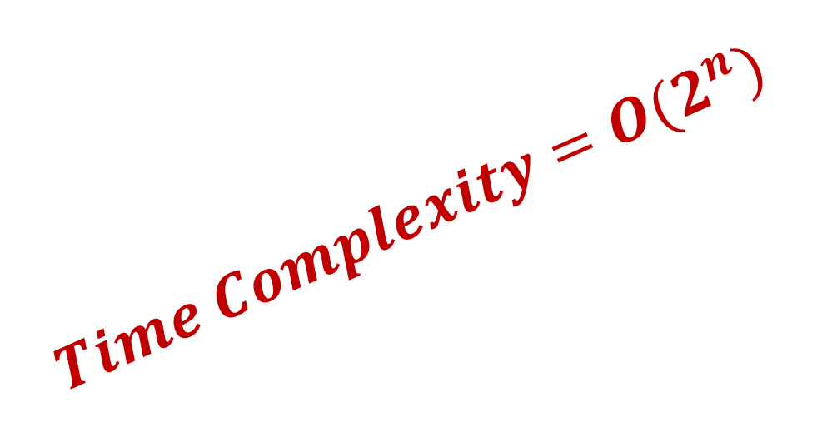
Backtracking
Problem 3 : Sum of Subset
  Example:
  If $n=4,\left\{w_{1},w_{2},w_{3},w_{4}\right\}=\left\{7, 11, 13, 24\right\} \text{and} m=31$, the desired solution sets are $(11, 13, 7), and (24, 7).$
S | K | R
0 | 1 | 55
1 | 2 | 3 | 4
7 | 11 | 13 | 24
$$x_{1}→$$
$$1$$
$$0$$
S | K | R
7 | 1 | 48
S | K | R
0 | 1 | 48
$$x_{2}→$$
$$1$$
$$0$$
$$1$$
$$0$$
$$Time Complexity=O(2^{n})$$
S | K | R
18 | 2 | 37
S | K | R
7 | 2 | 37
S | K | R
11 | 2 | 37
S | K | R
0 | 2 | 37
$$x_{3}→$$
$$0$$
$$0$$
$$1$$
$$0$$
$$1$$
$$0$$
$$1$$
$$0$$
$$1$$
S | K | R
31 | 3 | 24
S | K | R
18 | 3 | 24
S | K | R
20 | 3 | 24
S | K | R
7 | 3 | 24
S | K | R
24 | 3 | 24
S | K | R
11 | 3 | 24
S | K | R
13 | 3 | 24
S | K | R
0 | 3 | 24
$$x_{4}→$$
$$1$$
$$0$$
$$1$$
$$0$$
$$1$$
$$0$$
$$1$$
$$0$$
$$1$$
$$0$$
$$1$$
$$0$$
$$1$$
$$0$$
$$1$$
$$0$$
S | K | R
55 | 4 | 0
S | K | R
42 | 4 | 0
S | K | R
44 | 4 | 0
S | K | R
31 | 4 | 0
S | K | R
48 | 4 | 0
S | K | R
35 | 4 | 0
S | K | R
37 | 4 | 0
S | K | R
24 | 4 | 0
S | K | R
31 | 4 | 0
S | K | R
18 | 4 | 0
S | K | R
20 | 4 | 0
S | K | R
7 | 4 | 0
S | K | R
24 | 4 | 0
S | K | R
11 | 4 | 0
S | K | R
13 | 4 | 0
S | K | R
0 | 4 | 0

Slide 67
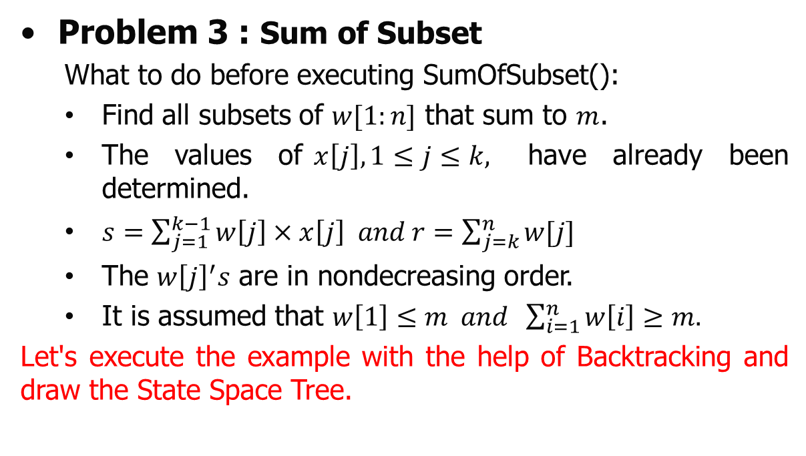
Backtracking
Problem 3 : Sum of Subset
  What to do before executing SumOfSubset():
  Find all subsets of $w[1:n]$ that sum to $m$.
  The values of$x\left[j\right], 1≤j≤k,$ have already been determined.
  $s=\sum_{j=1}^{k−1}{w\left[j\right]×x\left[j\right] and r=\sum_{j=k}^{n}{w[j]}}$
  The $w{\left[j\right]}^{′}s$ are in nondecreasing order.
  It is assumed that $w\left[1\right]≤m and \sum_{i=1}^{n}{w\left[i\right]≥m.}$
Let's execute the example with the help of Backtracking and draw the State Space Tree.

Slide 68

Backtracking
Problem 3 : Sum of Subset
Algorithm:
SumOfSubset(s, k, r)
{
// Generate left child. Note : $s+w\left[k\right]≤m.$
x[k]=1;
if (x[k]==0) return;
if (s + w[k]=m) then print (x[1:k]); // Subset found
//There is no recursive call here as w[j]>0, 1$≤$j $≤$n.
else if (s + w[k] +w[k+1] $≤$ m)
then SumOfSubset(s + w[k], k + 1, r - w[k]);
// Generate right child.
if ((s + r - w[k] $≥$ m) and (s+w[k+1] $≤$ m)) then
{
x[k]=0;
SumOfSubset(s, k + 1, r - w[k]);
}
}

Slide 69
Backtracking
Problems
  Hamiltonian cycle
  Graph Coloring
  Sum of subset
  N-Queen

Slide 70
Backtracking
Problem 4 : N Queen
  N-Queen problem is based on chess games.
  The problem is based on arranging the queens on chessboard in such a way that no two queens can attack each other.
  The N-Queen problem states as consider a n x n chessboard on which we have to place n queens so that no two queens attack each other by being in the same row or in the same column or on the same diagonal.

Slide 71
Backtracking
Problem 4 : N Queen
  2 – Queen’s problem is not solvable because 2 – Queens can be placed on 2 x 2 chess board as shown in below.
Q | Q
Q
 | Q
 | Q
 | Q
Q | Q
Q
Q
 | Q
Q

Slide 72
Backtracking
Problem 4 : N Queen
How to solve N-Queen Problem.
  Let us take the example of 4 – Queens and 4 x 4 chessboard.
  Start with an empty chessboard.
  Place queen 1 in the first possible position of its row i.e. on 1st row and 1st column
Q

Slide 73
Backtracking
Problem 4 : N Queen
How to solve N-Queen Problem.
  Then place queen 2 after trying unsuccessful place (1, 2), (2, 1), (2, 2) at (2, 3) i.e. 2nd row and 3rd column.
Q
 |  | Q

Slide 74
Backtracking
Problem 4 : N Queen
How to solve N-Queen Problem.
  This is a dead end because a 3rd queen cannot be placed in next column, as there is no acceptable position for queen 3. Hence algorithm backtracks and places the 2nd queen at (2, 4) position..
Q
 |  | Q
Q
 |  |  | Q

Slide 75
Backtracking
Problem 4 : N Queen
How to solve N-Queen Problem.
  Then place 3rd queen at (3,2) but it again another dead lock end as next queen (4th queen) cannot be placed at permissible position.
Q
 |  |  | Q
 | Q

Slide 76
Backtracking
Problem 4 : N Queen
How to solve N-Queen Problem.
  Hence we need to backtrack all the way up to queen 1 and move it to (1, 2). viii. Place queen 1 at (1, 2), queen 2 at (2, 4), queen 3 at (3, 1) and queen 4 at (4, 3).
  Thus the solution is obtained (2, 4, 1, 3) in row wise manner in x array.
 | Q
 | Q
 |  |  | Q
 | Q
 |  |  | Q
Q
 | Q
 |  |  | Q
Q
 |  | Q

Slide 77
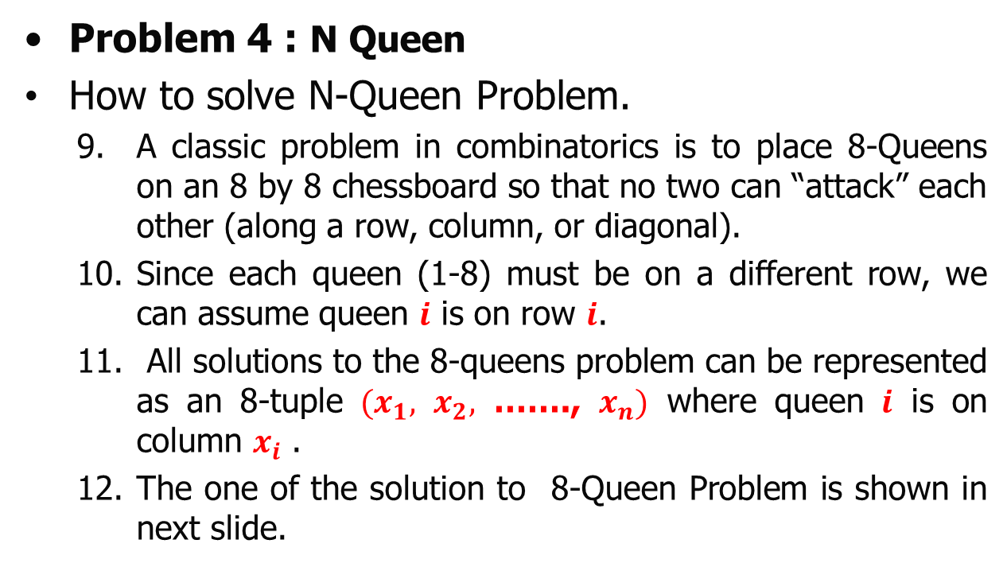
Backtracking
Problem 4 : N Queen
How to solve N-Queen Problem.
  A classic problem in combinatorics is to place 8-Queens on an 8 by 8 chessboard so that no two can “attack” each other (along a row, column, or diagonal).
  Since each queen (1-8) must be on a different row, we can assume queen $i$ is on row $i$.
  All solutions to the 8-queens problem can be represented as an 8-tuple $(x_{1},$ $x_{2},$ ……., $x_{n})$ where queen $i$ is on column $x_{i}$ .
  The one of the solution to 8-Queen Problem is shown in next slide.

Slide 78
Backtracking
Problem 4 : N Queen
  One of the solution to 8-Queen Problem
 |  |  |  |  | Q
 |  |  | Q
 |  |  |  |  |  | Q
Q
 |  | Q
 |  |  |  | Q
 | Q
 |  |  |  |  |  |  | Q

Slide 79
Backtracking
Problem 4 : N Queen
  N Queens are placed on n by n chessboard so that no two attack (no two queens are on the same row, column, or diagonal).
  A tree bellow shows the state space tree for n=4.
1
2
18
34
50

Slide 80
Backtracking
Problem 4 : N Queen
  N Queens are placed on n by n chessboard so that no two attack (no two queens are on the same row, column, or diagonal).
  A tree bellow shows the state space tree for n=4.
1
2
18
34
50
3
8
13
19
24
29
35
40
45
51
56
61

Slide 81

Backtracking
Problem 4 : N Queen
  N Queens are placed on n by n chessboard so that no two attack (no two queens are on the same row, column, or diagonal).
  A tree bellow shows the state space tree for n=4.
1
2
18
34
50
3
8
13
19
24
29
35
40
45
51
56
61
$$x_{3}=$$
4
6
9
11
14
16
20
22
25
27
30
32
36
38
41
43
46
48
52
54
57
59
62
64

Slide 82

Backtracking
Problem 4 : N Queen
  N Queens are placed on n by n chessboard so that no two attack (no two queens are on the same row, column, or diagonal).
  A tree bellow shows the state space tree for n=4.
1
2
18
34
50
3
8
13
19
24
29
35
40
45
51
56
61
$$x_{3}=$$
4
6
9
11
14
16
20
22
25
27
30
32
36
38
41
43
46
48
52
54
57
59
62
64
$$x_{4}=$$
5
7
10
12
15
17
21
23
26
28
31
33
37
39
42
44
47
49
53
55
58
60
63
65

Slide 83
Backtracking
Problem 4 : N Queen
  N Queens are placed on n by n chessboard so that no two attack (no two queens are on the same row, column, or diagonal).
  A tree bellow shows the state space tree for n=4.
It was observed that all possible solutions of
this example is O(n!)
1
2
18
34
50
3
8
13
19
24
29
35
40
45
51
56
61
$$x_{3}=$$
4
6
9
11
14
16
20
22
25
27
30
32
36
38
41
43
46
48
52
54
57
59
62
64
$$x_{4}=$$
5
7
10
12
15
17
21
23
26
28
31
33
37
39
42
44
47
49
53
55
58
60
63
65

Slide 84
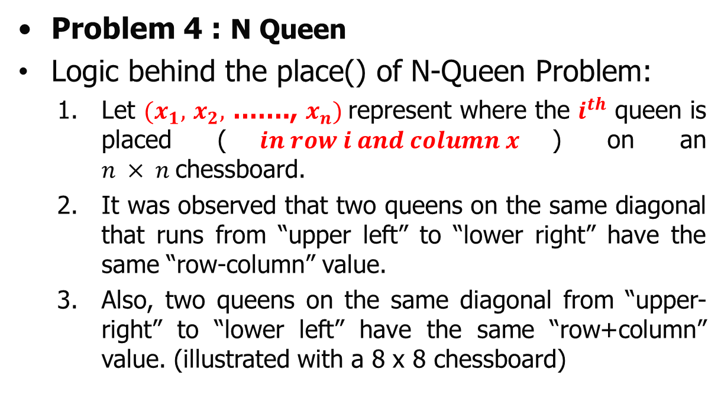
Backtracking
Problem 4 : N Queen
Logic behind the place() of N-Queen Problem:
  Let $(x_{1},$ $x_{2},$ ……., $x_{n})$represent where the $i^{th}$ queen is placed ($in row i and column x$) on an $n × n$chessboard.
  It was observed that two queens on the same diagonal that runs from “upper left” to “lower right” have the same “row-column” value.
  Also, two queens on the same diagonal from “upper-right” to “lower left” have the same “row+column” value. (illustrated with a 8 x 8 chessboard)

Slide 85
Backtracking
Problem 4 : N Queen
  Logic behind the place() of N-Queen Problem
 | 1 | 2 | 3 | 4 | 5 | 6 | 7 | 8
1
2
3
4 |  | Q
5
6
7
8
The Queen is available in [i,j] =[4,2]
The squares that are diagonal to that queen from upper left to lower right are [3,1], [5,3], [6,4], [7,5], and [8,6]. (Note : All these squares have a “row-column” value of 2)
Similarly, the squares that are diagonal to that queen from upper right to lower left are [1,5], [2,4], [3,3], and [5,1]. (Note : All these squares have a “row+column” value of 6)

Slide 86
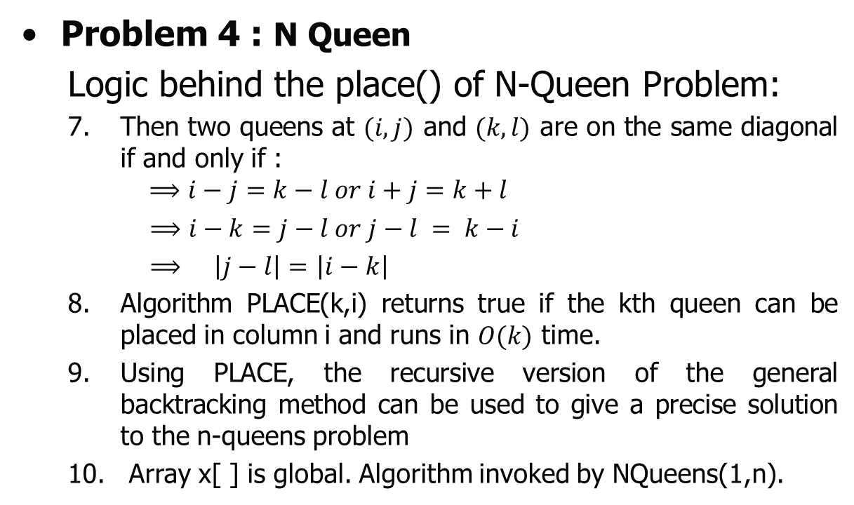
Backtracking
Problem 4 : N Queen
  Logic behind the place() of N-Queen Problem:
  Then two queens at $(i,j)$ and $(k,l)$ are on the same diagonal if and only if :
  $$⟹i−j=k−l or i+j=k+l$$
  $⟹i−k=j−l or j−l = k−i$
  $⟹$ $\left|j−l\right|=$ $\left|i−k\right|$
  Algorithm PLACE(k,i) returns true if the kth queen can be placed in column i and runs in $O(k)$ time.
  Using PLACE, the recursive version of the general backtracking method can be used to give a precise solution to the n-queens problem
  Array x[ ] is global. Algorithm invoked by NQueens(1,n).

Slide 87
Backtracking
Problem 2 : N Queen (Algorithm)
  Recursive algorithm for N-Queen
void NQueens(int k, int n)
// Using backtracking, this procedure prints all possible placements of n queens
// on an n x n chessboard so that they are nonattacking.
{
for i=1 to n do
{
if (Place(k, i))
{
x[k] = i;
if (k==n)
print (x[1:n])
else
NQueens(k+1, n);
}
}
}

Slide 88
Backtracking
Problem 2 : N Queen (Algorithm)
  Recursive algorithm for N-Queen
bool Place(int k, int i)
// Returns true if a queen can be placed in kth row and ith column. Otherwise it
// returns false. x[] is a global array whose first (k-1) values have been set. abs(r)
// returns the absolute value of r.
{
for j= 1 to k-1 do
if ((x[j] == i) or // Two in the same column
|| (abs(x[j]-i) == abs(j-k))) // or in the same diagonal
return(false);
return(true);
}

Slide 89

Thank U

